Slide 1

Mathematical Statistics Project
Name: Aarsh Sachdeva
A#: A20595501

Slide 2
What are we aiming to do?
Clean and preprocess the bicycle demand data.
Perform Residual analysis and statistical inference on the data.
Fitting linear models (Linear regression, regularized linear models and Robust linear regression) & Generalized linear models (Poisson model & Negative Binomial model) on the data.
Determine the ML/ statistical model best fit for the data.

Slide 3
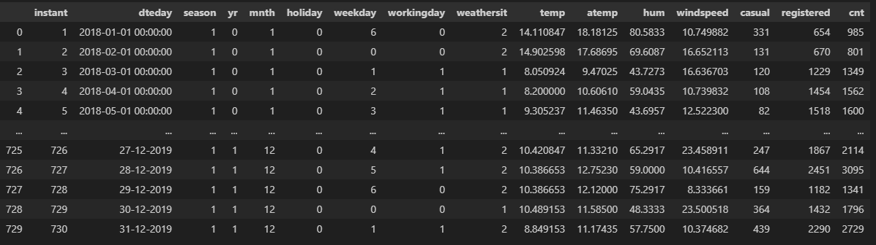
How does the data look like?
Input
Output
Dropping these columns before starting with analysis as these are redundant and do not provide any additional information
Although these have numerical values but due to low cardinality and discrete values these are categorical columns.
Would require dummy variable to work with these columns.
Numerical columns (columns having continuous values) these would require scaling.

Slide 4
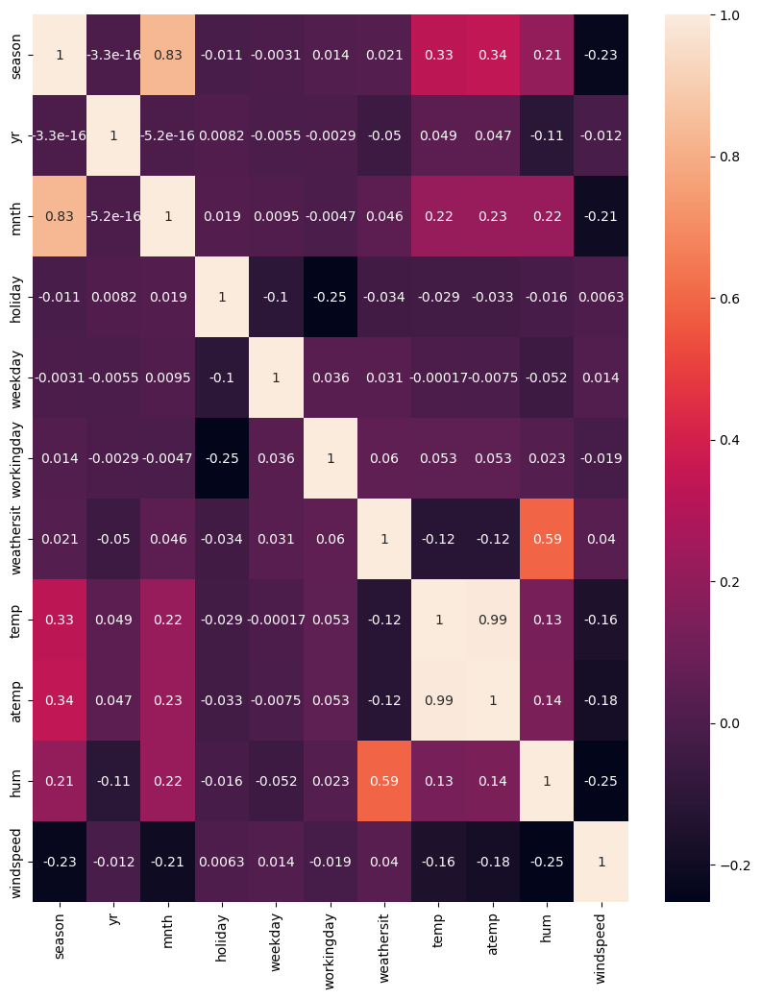
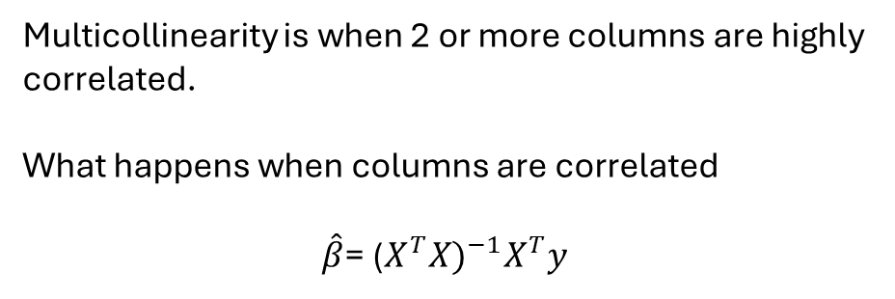
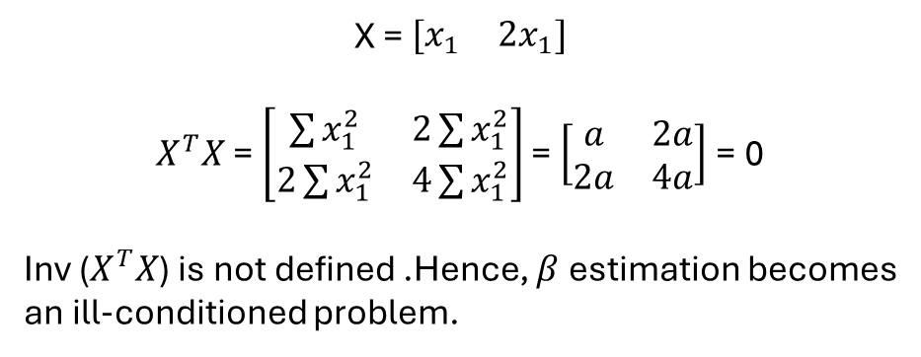
Next steps:
1) Checking for multicollinearity in the data
Multicollinearity is when 2 or more columns are highly correlated.
What happens when columns are correlated
$\hat{β}$= ${\text{(}X^{T}X)}^{−1}X^{T}y$
X = $\begin{matrix}{[x}_{1} & {2x}_{1}]\end{matrix}$
$X^{T}X$ = $\left[\begin{matrix}\sum{x_{1}^{2}} & 2\sum{x_{1}^{2}} \\ 2\sum{x_{1}^{2}} & 4\sum{x_{1}^{2}}\end{matrix}\right]$ = $\left[\begin{matrix}a & 2a \\ 2a & 4a\end{matrix}\right]$ = 0
Inv ($X^{T}X$) is not defined .Hence, $β$ estimation becomes
an ill-conditioned problem.
Will drop it

Slide 5
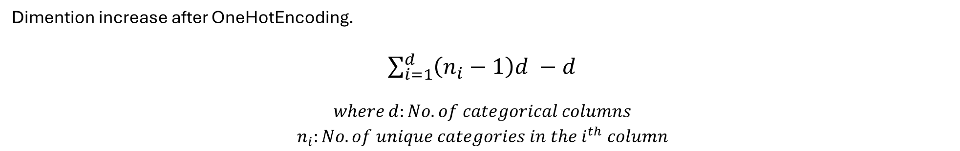
Next steps:
2) Preprocessing
OneHotEncoding: Used for encoding categorical and avoid introduction of pseudo-hierarchy which is untrue.
from sklearn.preprocessing import OneHotEncoder
Ohe=OneHotEncoder(drop=‘first’,sparse_output=False,handle_unknown='ignore')
Done before splitting the data as it may lead to some categories being missing in the test data specially in sequential data splitting (like this case).
Dimention increase after OneHotEncoding.
$\sum_{i=1}^{d}{\left(n_{i}−1\right)d −d}$
$$\begin{aligned}where d:No. of categorical columns \\ n_{i}:No. of unique categories in the i^{th} column\end{aligned}$$

Slide 6
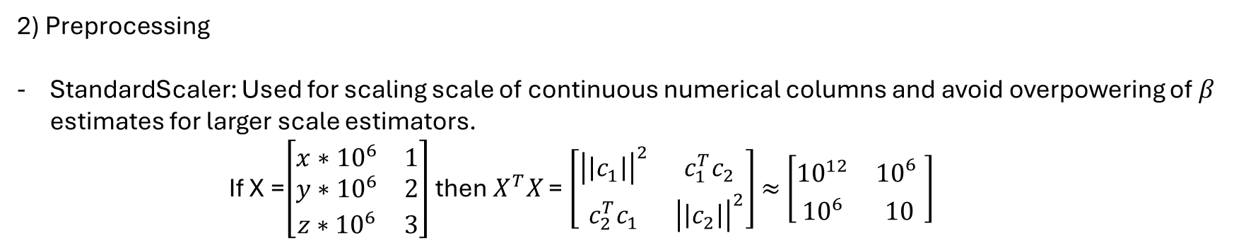
Next steps:
2) Preprocessing
StandardScaler: Used for scaling scale of continuous numerical columns and avoid overpowering of $β$ estimates for larger scale estimators.
If X =$\left[\begin{matrix}{x∗10}^{6} & 1 \\ y∗{10}^{6} & 2 \\ z∗{10}^{6} & 3\end{matrix}\right]$ then $X^{T}X$ = $\left[\begin{matrix}{\left|\left|c_{1}\right|\right|}^{2} & c_{1}^{T}c_{2} \\ c_{2}^{T}c_{1} & {\left|\left|c_{2}\right|\right|}^{2}\end{matrix}\right]$ $≈$ $\left[\begin{matrix}{10}^{12} & {10}_{}^{6} \\ {10}^{6} & 10\end{matrix}\right]$
${K(X}^{T}X)$=$\frac{λ_{max}}{λ_{min}}$ $≈{10}^{11}$ (ill-conditioned as $λ_{max}$ >>> $λ_{min}$)
Done after splitting the data as it may lead to data leakage overfitting Poor predictions
After scaling through StandardScaler the distribution of each column ~ N(0,1)
from sklearn.preprocessing import StandardScaler
sc= StandardScaler()

Slide 7
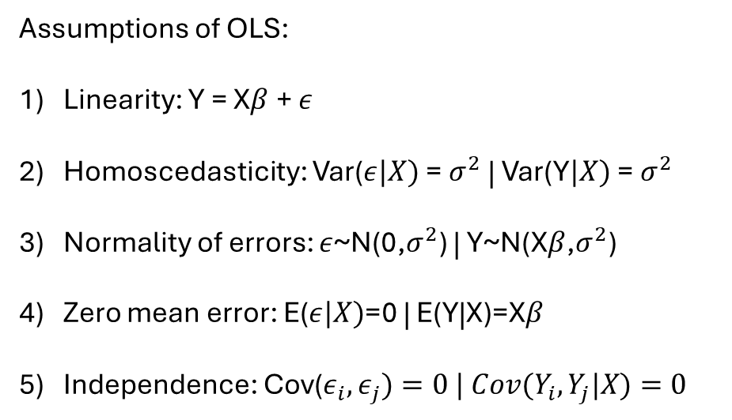
Assumptions of OLS:
Linearity: Y = X$β$ + $ε$
Homoscedasticity: Var($ε|X)$ = $σ^{2}$ | Var(Y$|X)$ = $σ^{2}$
Normality of errors: $ε$~N(0,$σ^{2}$) | Y~N(X$β$,$σ^{2}$)
Zero mean error: E($ε|X)$=0 | E(Y|X)=X$β$
Independence: Cov($ε_{i},ε_{j})=0 | Cov(Y_{i},Y_{j}|X)=0$
Always 0 by construction for an OLS model with intercept.

Slide 8
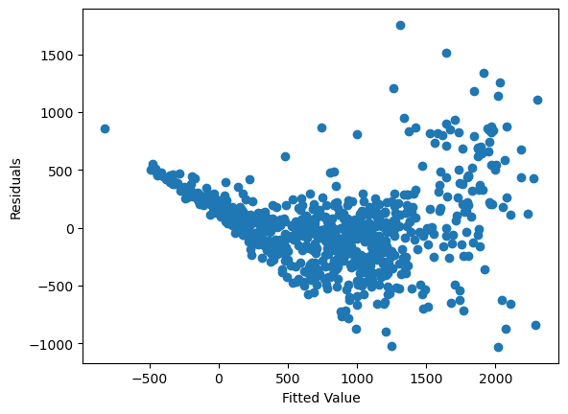
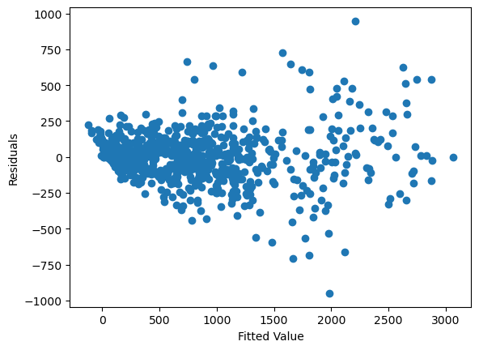
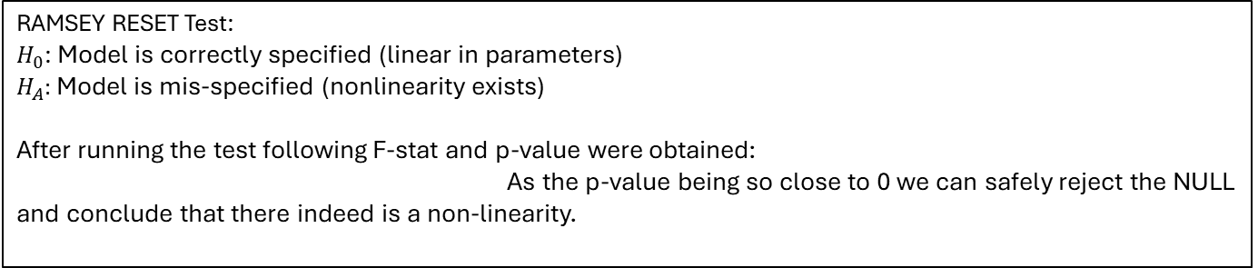
Next steps:
3) Residual Analysis
Fitted v/s Residual values:
The residual v/s Fitted value plot shows a non-linear structure and requires polynomial features
Obtained polynomial features from the existing features and the plot now seems more balanced across the 0 line
RAMSEY RESET Test:
$H_{0}$: Model is correctly specified (linear in parameters)
$H_{A}:$ Model is mis-specified (nonlinearity exists)
After running the test following F-stat and p-value were obtained:
As the p-value being so close to 0 we can safely reject the NULL and conclude that there indeed is a non-linearity.

Slide 9
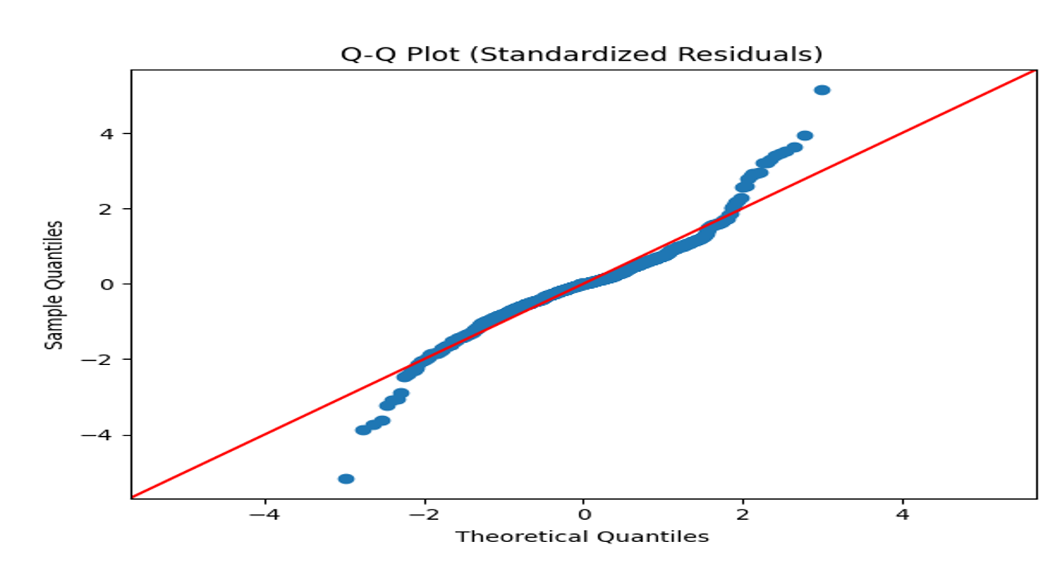
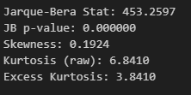
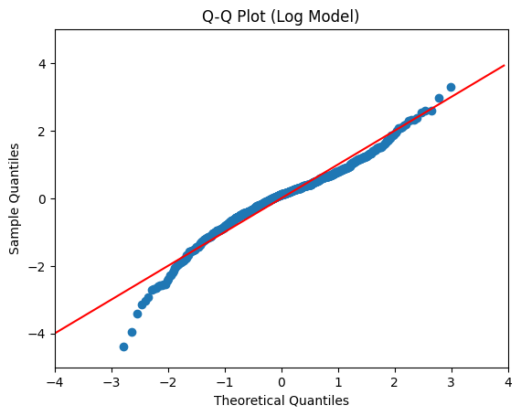
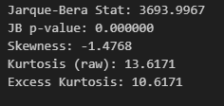
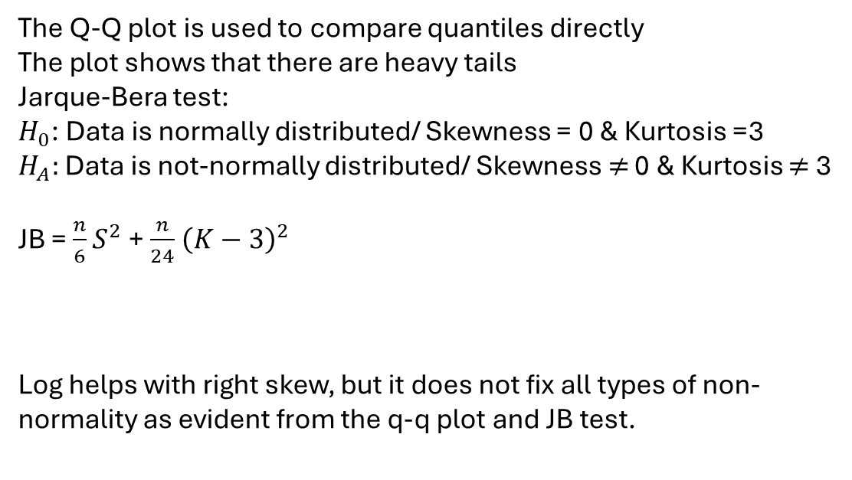
Q-Q Plot
The Q-Q plot is used to compare quantiles directly
The plot shows that there are heavy tails
Jarque-Bera test:
$H_{0}$: Data is normally distributed/ Skewness = 0 & Kurtosis =3
$H_{A}:$ Data is not-normally distributed/ Skewness $≠$ 0 & Kurtosis $≠$ 3
JB = $\frac{n}{6}S^{2}$ + $\frac{n}{24}$ ${\left(K−3\right)}^{2}$
Log helps with right skew, but it does not fix all types of non-normality as evident from the q-q plot and JB test.
Such data behavior can be due to data:
Being discrete/ Count
Having left tail heavy
Overdispersion (will talk about it later)

Slide 10
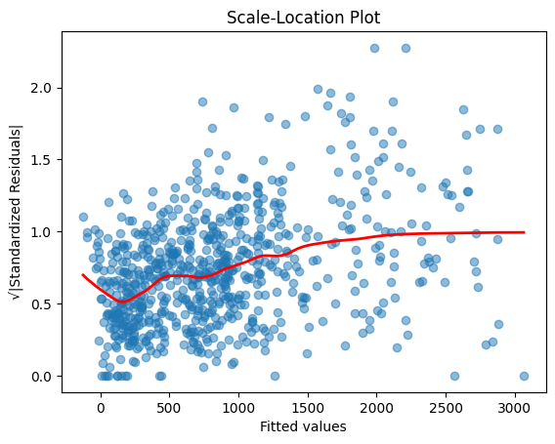

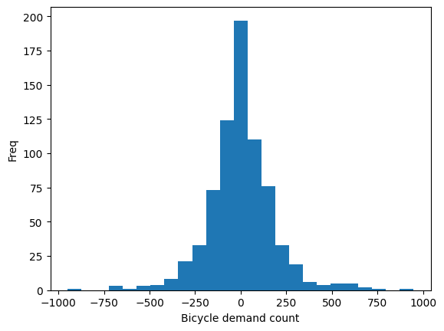
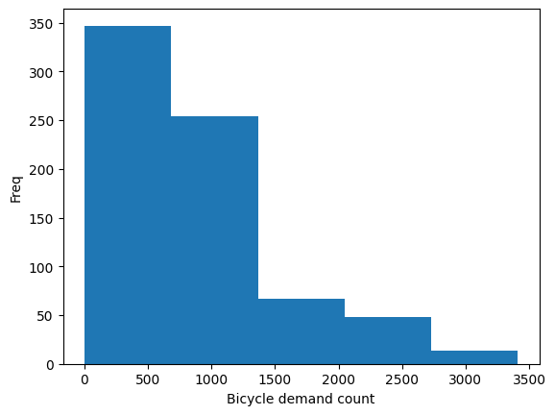
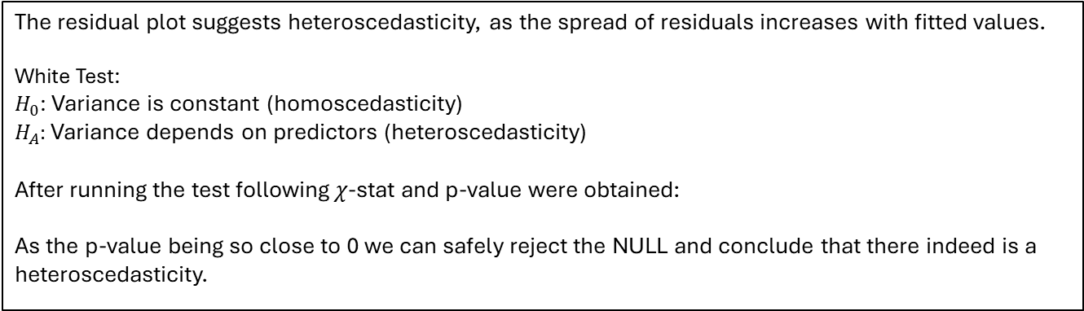
The residual plot suggests heteroscedasticity, as the spread of residuals increases with fitted values.
White Test:
$H_{0}$: Variance is constant (homoscedasticity)
$H_{A}:$ Variance depends on predictors (heteroscedasticity)
After running the test following $χ$-stat and p-value were obtained:
As the p-value being so close to 0 we can safely reject the NULL and conclude that there indeed is a heteroscedasticity.
Linear models including linear regression, regularized linear regression, or robust linear regression should not be used when the output is count because the predictions are always continuous and $∈$(-inf,inf)
Constant Variance assumption violated
Normal error assumption violated
Continuous Support
LR prediction
Output Variable
SUMMARY: We can capture nonlinearity by including polynomial features, preserving linearity in the parameters. The residuals remain non-normal, which does not affect the unbiasedness of OLS estimates but does make inference unreliable. However, the presence of heteroscedasticity and the non-Gaussian nature of the response indicate a mis-specified error distribution. Therefore, we move to a GLM framework, which models both the mean and variance appropriately.

Slide 11
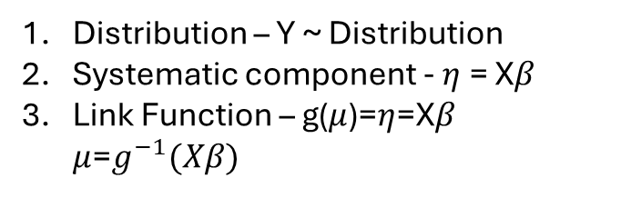
Generalized Linear Models
GLMs are framework used to extend linear regression to handle:
Non-Normal data
Non-Constant variance
Non-linear relationship (via transformation)
But it still has some assumption which it carries from linear regression:
Independence
No Multicollinearity
Zero mean
Distribution – Y ~ Distribution
Systematic component - $η$ = X$β$
Link Function – g($μ$)=$η$=X$β$ $μ$=$g^{−1}(Xβ)$
Components of GLMs

Slide 12
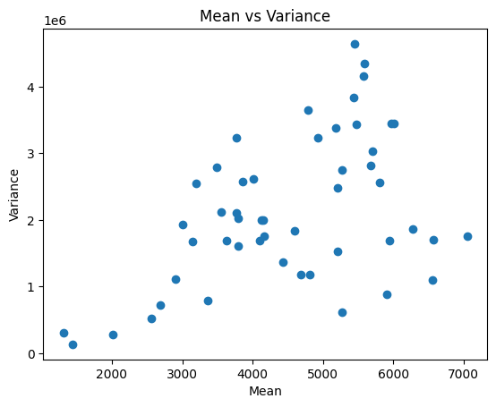
Since variance increases with the mean, constant-variance models are inappropriate. GLMs are suitable because exponential family distributions explicitly define variance as a function of the mean
For exponential family variance is a function of the mean:
Var(Y|X) = f($μ$)
The GLM models which have output range from [0,inf) would be fit for our data. Some, GLMs with +ve output are:
Poisson Regression
Negative Binomial Regression
Inverse Gaussian Regression

Slide 13
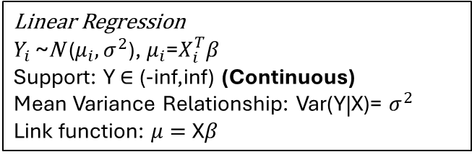
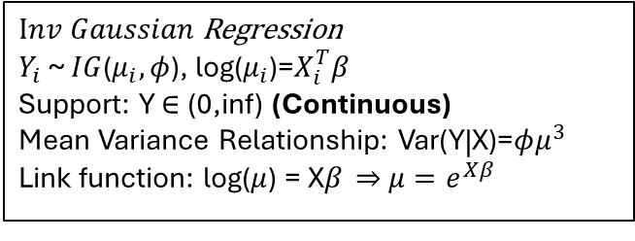
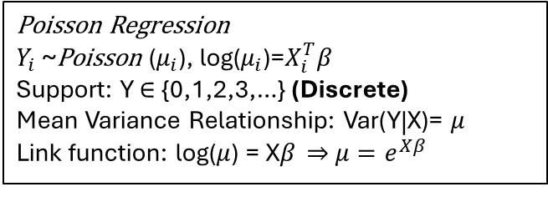
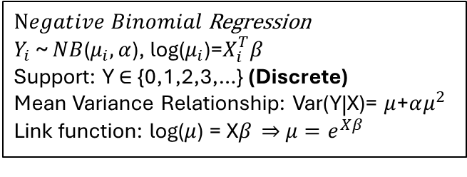
Linear Regression
$Y_{i}$ ~N ($μ_{i},σ^{2}$), $μ_{i}$=$X_{i}^{T}β$
Support: Y $∈$ (-inf,inf) (Continuous)
Mean Variance Relationship: Var(Y|X)= $σ^{2}$
Link function: $μ=$ X$β$
Output is continuous and support is (-inf,inf) not ideal for count data
Poisson Regression
$Y_{i}$ ~Poisson ($μ_{i}$), log($μ_{i}$)=$X_{i}^{T}β$
Support: Y $∈$ {0,1,2,3,…} (Discrete)
Mean Variance Relationship: Var(Y|X)= $μ$
Link function: log($μ$) = X$β \overset{⇒}{}$ $μ=e^{Xβ}$
Support is discrete maybe fit for such a data
$Negative Binomial$Regression
$Y_{i}$ ~ $NB$($μ_{i},α$), log($μ_{i}$)=$X_{i}^{T}β$
Support: Y $∈$ {0,1,2,3,…} (Discrete)
Mean Variance Relationship: Var(Y|X)= $μ$+$αμ^{2}$
Link function: log($μ$) = X$β \overset{⇒}{}$ $μ=e^{Xβ}$
Support is discrete maybe fit for such a data
$Inv Gaussian$Regression
$Y_{i}$ ~ $IG$($μ_{i},φ$), log($μ_{i}$)=$X_{i}^{T}β$
Support: Y $∈$ (0,inf) (Continuous)
Mean Variance Relationship: Var(Y|X)=$φμ^{3}$
Link function: log($μ$) = X$β \overset{⇒}{}$ $μ=e^{Xβ}$
Support is continuous not ideal for count data

Slide 14

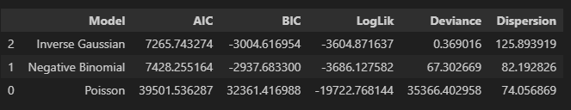
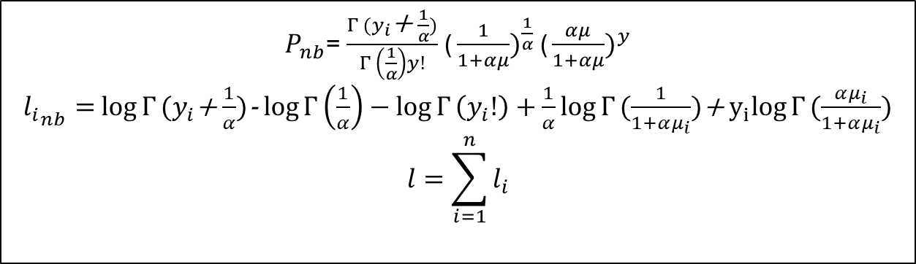
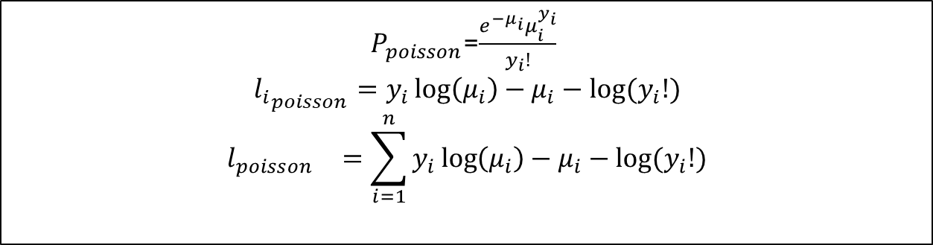
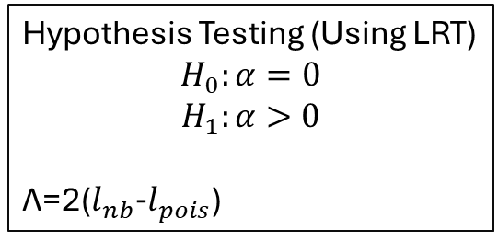
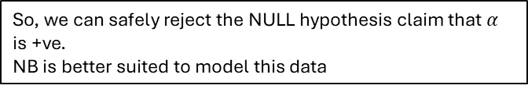
Hypothesis Testing (Using LRT)
$$H_{0}:α=0$$
$$H_{1}:α>0$$
Λ=2($l_{nb}$-$l_{pois}$)
$P_{poisson}$=$\frac{e^{−μ_{i}}μ_{i}^{y_{i}}}{y_{i}!}$
$${l_{i}}_{poisson}=y_{i}\log\left(μ_{i}\right)−μ_{i}−log⁡(y_{i}!)$$
$${l_{poisson}}_{}=\sum_{i=1}^{n}{y_{i}\log\left(μ_{i}\right)−μ_{i}−log⁡(y_{i}!)}$$
df =2
df =1
$P_{nb}$= $\frac{Γ (y_{i}\text{+ }\frac{1}{α})}{Γ \left(\frac{1}{α}\right)y!}$ ${\text{(}\frac{1}{1+αμ})}^{\frac{1}{α}}$ ${\text{(}\frac{αμ}{1+αμ})}^{y}$
${l_{i}}_{nb}=$ $\log{Γ}(y_{i}$+ $\frac{1}{α})$- $\log{Γ}\left(\frac{1}{α}\right)−\log{Γ}\left(y_{i}!\right)+\frac{1}{α}log{Γ}(\frac{1}{1+αμ_{i}})$+ $y_{i}log{Γ}(\frac{αμ_{i}}{1+αμ_{i}})$
$$l=\sum_{i=1}^{n}{l_{i}}$$
$χ_{0.05,1}^{2}$ $≈$ 3.84 and any p-value < 0.05 we reject the NULL
So, we can safely reject the NULL hypothesis claim that $α$ is +ve.
NB is better suited to model this data

